Slide 1
EE 735 (Microelectronics Simulation Lab)
Assignment -2
(16th August 2023)
Instructor: Prof. Sourabh Lodha
TA : Simhadri Venkata Ramana
Ph no: 9032902781
Mail: 22m1201@iitb.ac.in

Slide 2


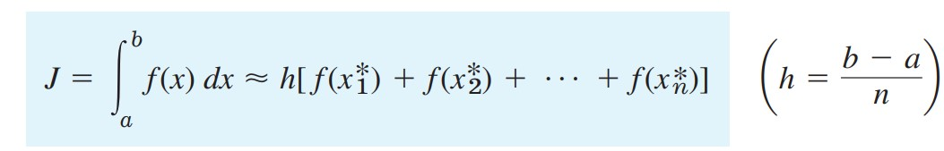
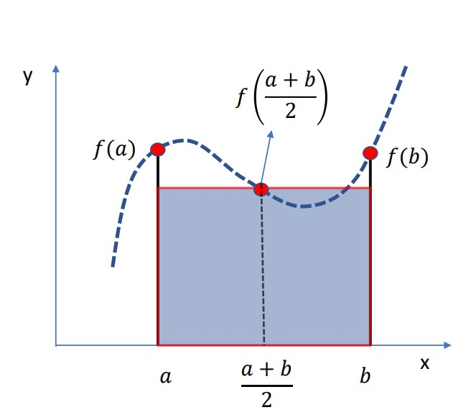
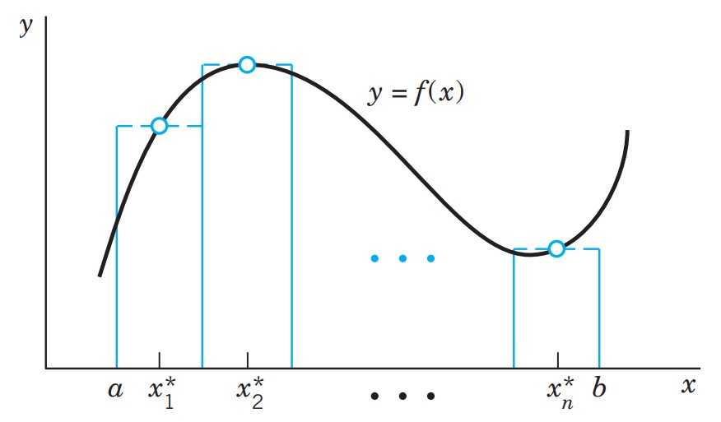
Numerical Integration Techniques
Rectangular method ,
For n points equation becomes,

Slide 3
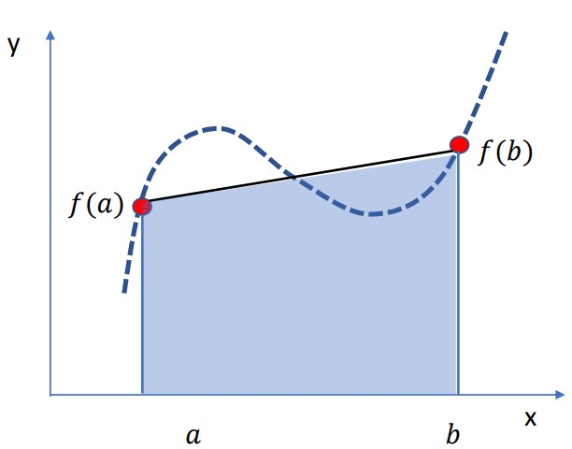
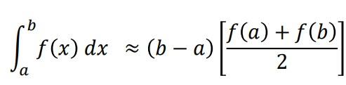
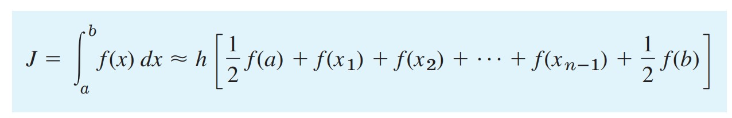
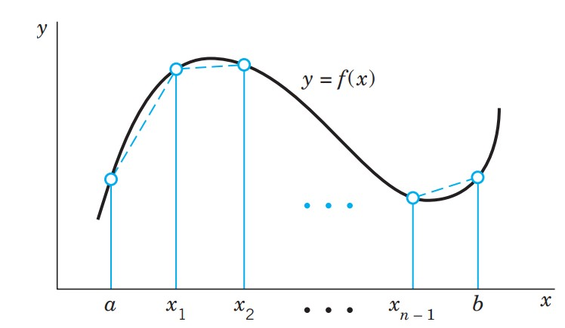
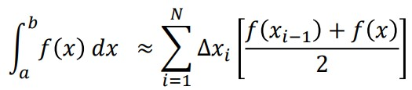
Trapezoidal Rule
Numerical integration:
$$i$$

Slide 4
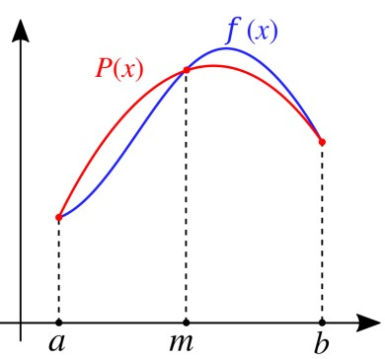
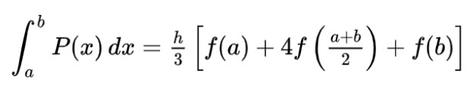
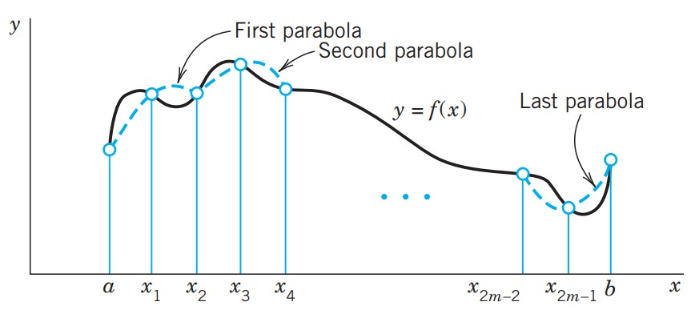
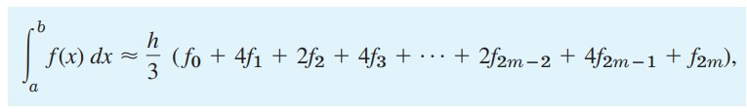
Simpson’s One-Third Rule
Approximating f(x) by the Lagrange polynomial P(x) we get,
by integrating P(x),
NOTE: To apply Simpson 1/3 rule, no of steps should be EVEN
Numerical integration:
Extra learning resource : Link

Slide 5
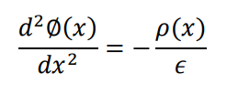
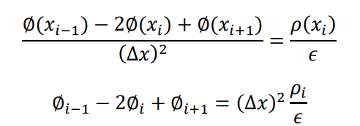
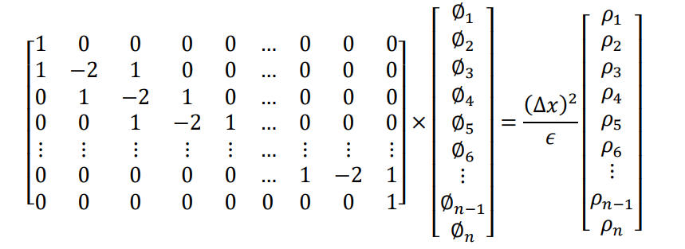
Solving Poisson Equation by Finite Difference scheme:
One dimensional Equation:
where
ø = voltage, ∆x= step size

Slide 6
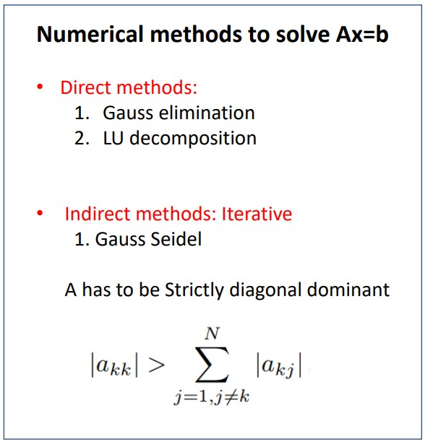

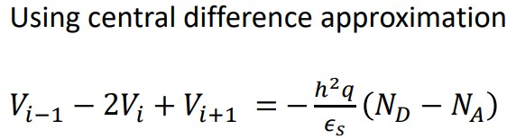

Solving Poisson’s equation
For a step graded Junction
Re-write these equations as system of linear equations with n variable :

Slide 7

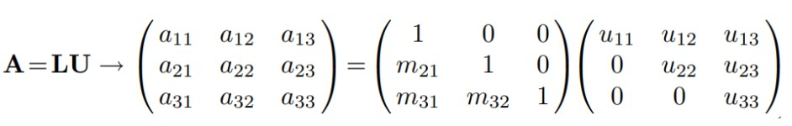
LU Decomposition method
The operation count of LU decomposition is much lesser than Gauss elimination.
decompose 𝐴 𝑖𝑛𝑡𝑜 𝐿 𝑎𝑛𝑑 𝑈 matrix
AV = b LUV = b
Solve Ly = b then UV=y : these can be solved by forward and backward substitutions respectively

Slide 8
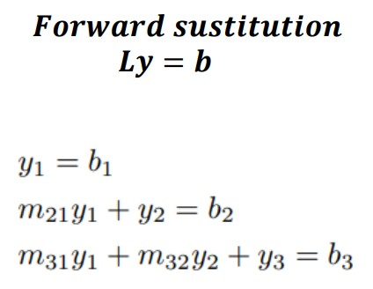
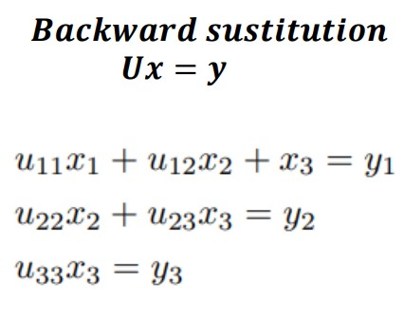
LU decomposition method for AV=b :

Slide 9
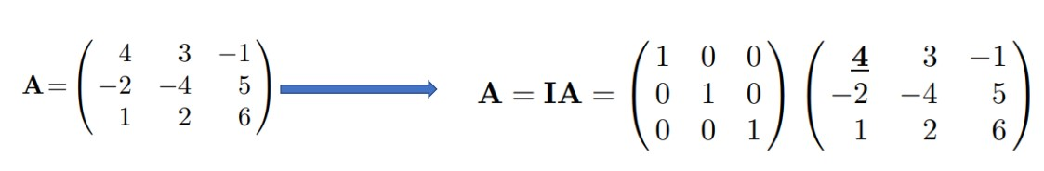
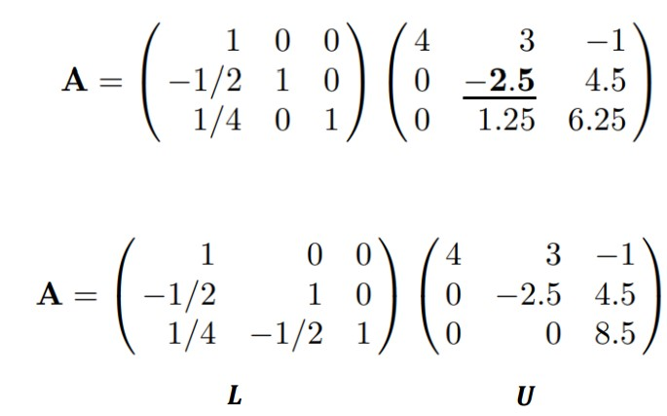
LU factorization Example:
R2 R2 - (-2/4) R1
R3 R3 - (1/4)R1
R3 R3 - (-1.25/2.5)R2
YouTube Reference: click here

Slide 10
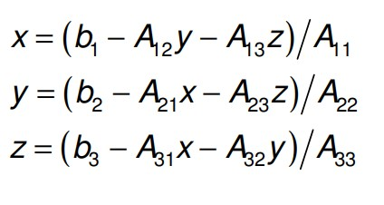
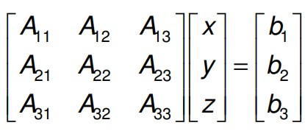
Gauss-Seidel Method:
only be applied to square linear systems (n equations in n unknowns)
Iterative methods for Ax = b begin with an approximation to the solution, x0
For certain problems (particularly those where the matrix A is large and sparse) they are much faster than direct methods.

Slide 11
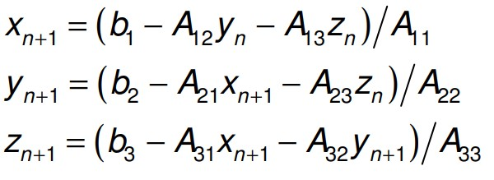
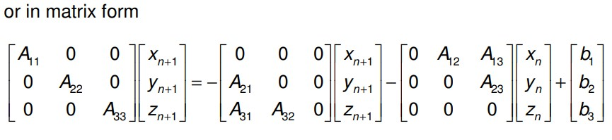





Gauss-Seidel Method:
where D is a 3 × 3 matrix containing the diagonal part of A, and L and U are 3 × 3 matrices containing the (strictly) lower and (strictly) upper triangular parts of A
(Note that the L and U matrices here have nothing to do with those in the factorization A = LU)
Where,
and

Slide 12
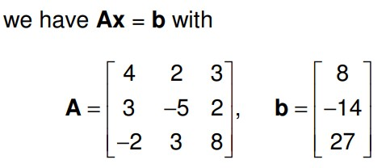
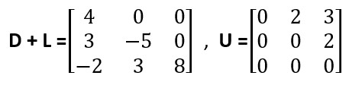
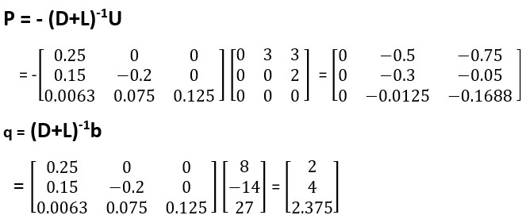
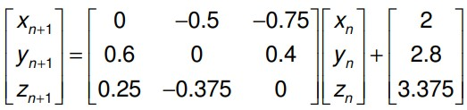


Gauss-Seidel Example:
We first split A into
Gauss-Seidel iterations are given by X_{n+1}=Px_{n}+q , i.e.

Slide 13
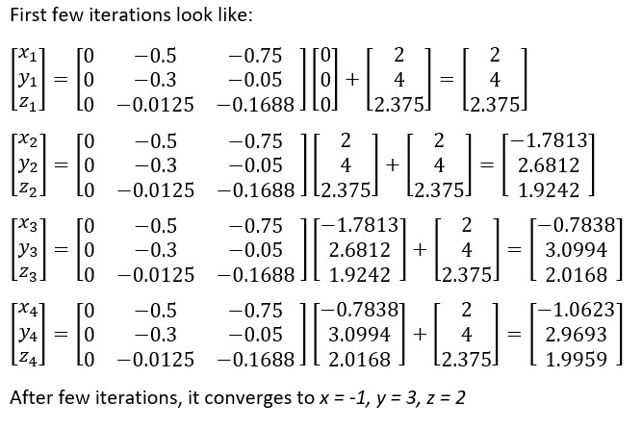
Gauss-Seidel Example:

Slide 14
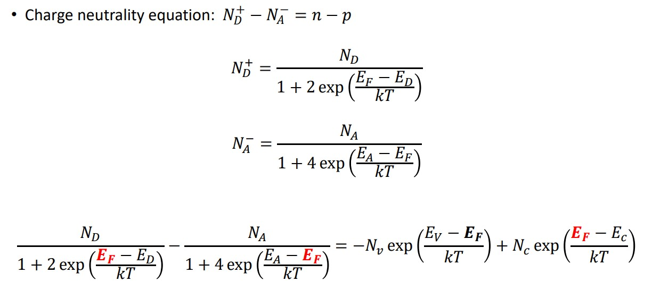
System of non-linear equations

Slide 15
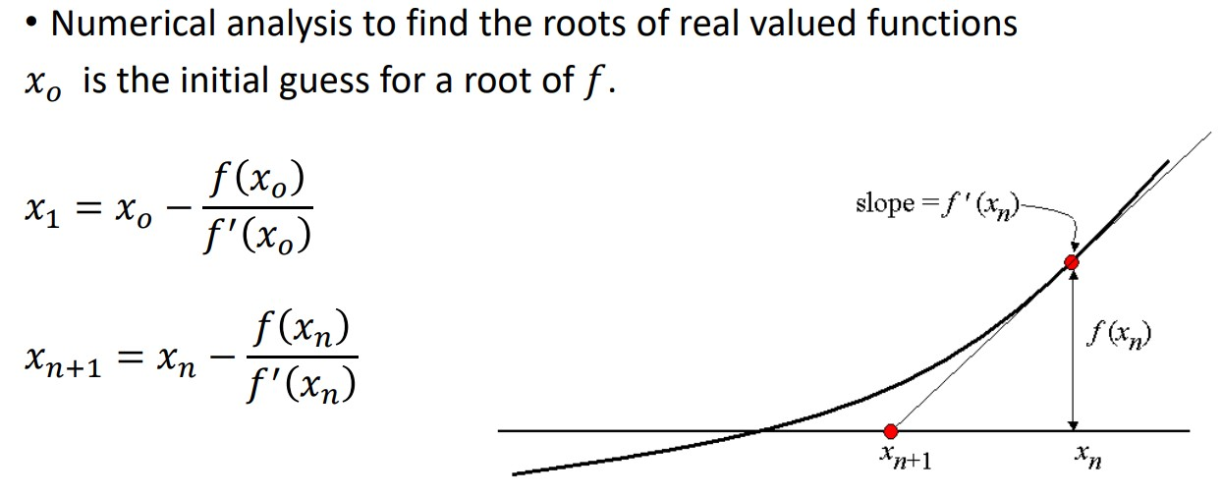
Newton Raphson Method
Youtube reference link: Click Here
Hint: F = @(x) ……..<equation> ; F is a function with variable x
F@(x(k)) is substituting k in place of x in Fun

Slide 16
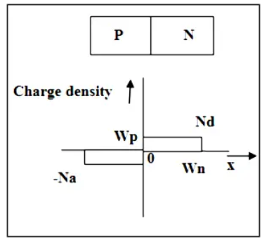
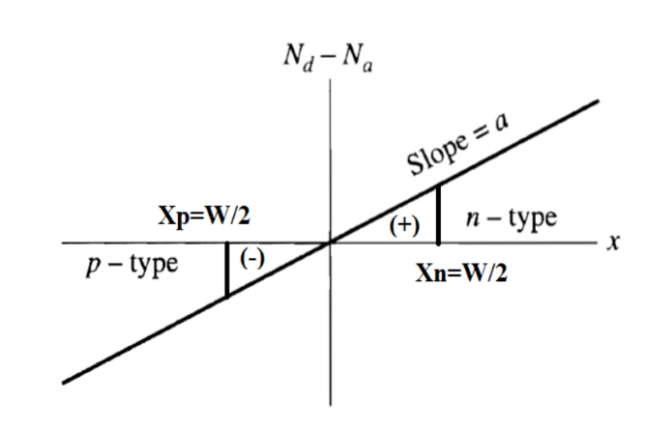

Question 1
Solve the following for PN junction diode shown in the figure by considering both abrupt and linearly graded junction.
(Parameters: Length of P region= Length of N region = 2e-6 meters, N region doping (Nd) = 1e15cm³,built-in potential V_{bi} = 0.6V, ε_{Si} = 11.8 ,$ε_{0}=$8.85e-14 F/cm, n_{i} (constant) =10¹⁰ /cm³ , q=1.6e-19 C )
Threshold voltage (V_{t}) = KT/q= 0.02600 V @ 300 K (for V_{t} consider upto 5 digits after decimal), Where T=300+1.5*X Kelvin, where X last digit of your roll number.

Slide 17
Question 1- continuation
Plot the Charge profile, Electric field and Voltage profile by solving the Gauss Law for the given PN junction diode using numerical integration techniques such as Trapezoidal/Simpson’s methods. Compare the result with the inbuilt MATLAB functions for integration. You can check the accuracy of numerically integrated results by varying the grid spacing.
By replacing the continuous partial derivatives by finite-difference Equation as shown below, ∇²𝑉_{(𝑖)} = (𝑉_{(𝑖−1)} − 2𝑉_{(𝑖)} + 𝑉_{(𝑖+1)})/ℎ². solve the Poisson equation with depletion approximation. For this calculation first compute the L and U matrices numerically. Use these matrices to solve the system of linear equations [𝐴]_{𝑛×𝑛} [𝑉]_{𝑛×1} = [𝑏]_{𝑛×1} using LU decomposition method (Do not use inbuilt LU command) and compare graphically the result with inbuilt MATLAB operator 𝐴\𝑏.
Use Gauss-Seidel method to solve the linear equations [𝐴]_{𝑛×𝑛} [𝑉]_{𝑛×1} = [𝑏]_{𝑛×1} and compare the result graphically with result got from part B.

Slide 18
Question 2
Consider a compensated semiconductor (Si) bar with doping concentrations 𝑁_{𝐷} = 1𝑒15 𝑐𝑚⁻³ 𝑎𝑛𝑑 𝑁_{𝐴} = 1𝑒17 𝑐𝑚⁻³. Use Newton Raphson method to solve the charge neutrality equation for finding the fermi energy 𝐸_{𝐹}. Plot Energy band diagram depicting conduction band minimum (EC), valence band maximum (EV), mid gap energy level (Emid), fermi energy level EF. Mention all the assumptions made.

Slide 19
Thank you..

